Slide 2
Mark 8:14-21
Using Everyday Objects to Teach Us About Spiritual Things
Significant Thing About Yeast Is Its Power - Matthew Chapter 13

Slide 3
“Watch Out For The Yeast”

Slide 4
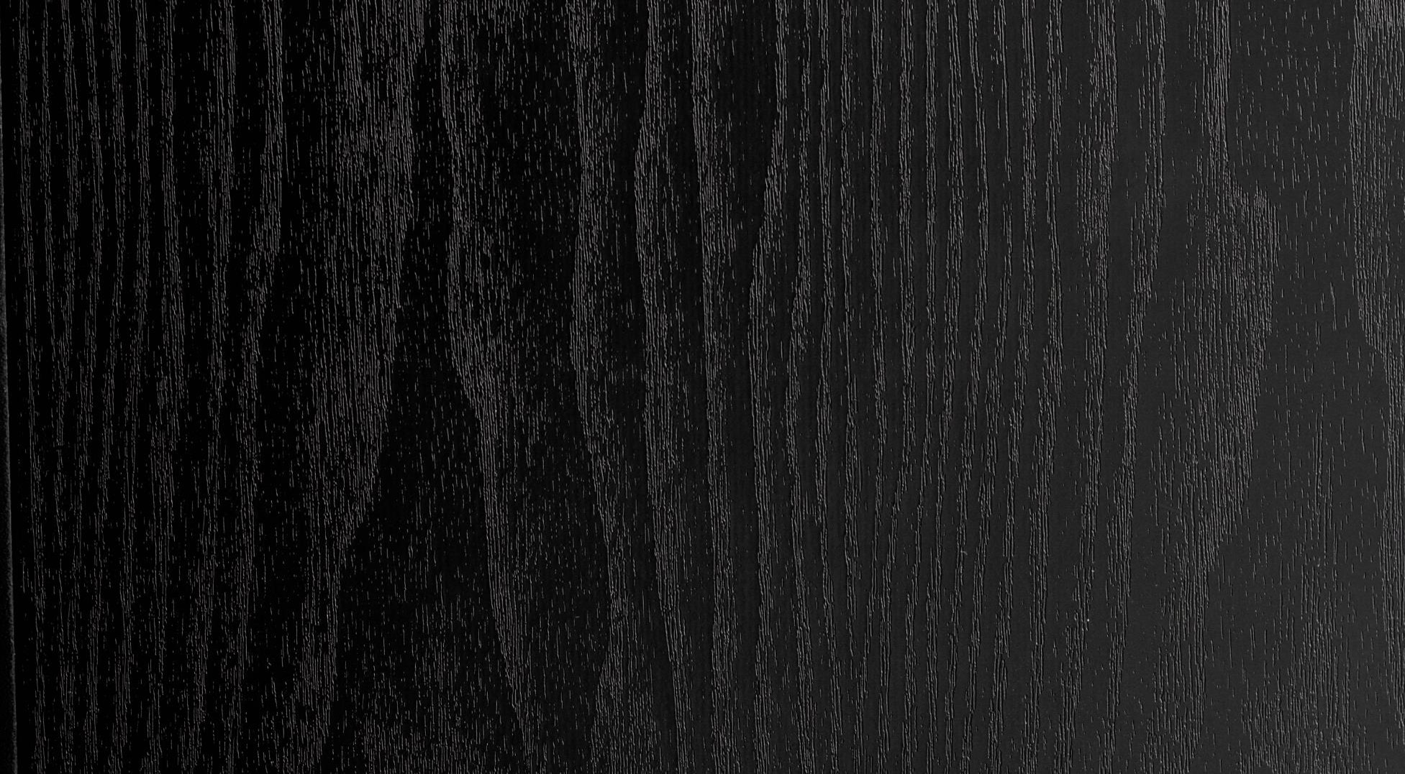

Presentation Cover Title
Four Obstacles To FAITH

Slide 5
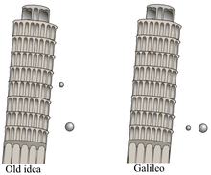
YEAST OR LEAVEN OF THE PHARISEES
1. TRADITIONALISM
Held own traditions above law of God
A COUPLE OF REASONS WHY TRADITIONALISM IS DANGEROUS-
  “I’ll do it the old way even if the new way is better.”
  Aristotle vs Galileo – OLD / GALILEO
  Continued to say Aristotle was RIGHT!

Slide 6
YEAST OR LEAVEN OF THE PHARISEES
A COUPLE OF REASONS WHY TRADITIONALISM IS DANGEROUS-
  Jesus Fed 4,000 people with 7 Loaves if Bread and a Few Small Fish – so caught up in their tradition even this sure sign could not convince them the new way was better
“BUT WE’VE NEVER DONE IT THAT WAY BEFORE!”
  Need not be concerned with how things were done before but how GOD want them done NOW!
Nothing wrong with TRADITION – only TRADITIONALISM!

Slide 7
YEAST OR LEAVEN OF THE PHARISEES
2. SECULARISM
  Jesus spoke of the Herodians who plotted to kill Him
  Herodians believed they could change the world with their politics – secularists – faith in government not God!
  Very Prevalent in Society Today – Solve World Problems; Take Care of our Finances; Take Care of Crime problem; Take Care of our Health Care; Take Care of Teaching our Children; Take care of telling us what is RIGHT and WRONG!
  Secularists believe Government must make our decisions for us because we are incapable of making them on our own!

Slide 8
YEAST OR LEAVEN OF THE PHARISEES
2. SECULARISM
Our Faith Is Not In Secularism But In A Savior
  We don’t need a handout from Washington – we need a hand-up from God
3. SKEPTICISM
  Matthew 16:6 “Pharisees and Sadducees”
  Sadducees known for their skepticism – Mark 12; Acts 23:8
  They had a form of religion yet denied its power

Slide 9
YEAST OR LEAVEN OF THE PHARISEES
3. SKEPTICISM
  Jesus Warns Against Those Who Claim To Believe In God Yet Deny That God Is Able To Work In The Supernatural Realm
  Skepticism eats away at the core of our faith!
  Many don’t believe God created the world – if he couldn’t create the world how can I believe I was created in His image?
  Many don’t believe the Bible is without error – if I don’t believe every word is true, how can I believe any of it?

Slide 10
YEAST OR LEAVEN OF THE PHARISEES
3. SKEPTICISM
  Many who don’t believe in virgin birth of Christ – if I cannot base my faith on these facts I have no faith, no hope and no salvation!
  When I cease to believe in the supernatural – I cease to have faith in a Savior!
  SKEPTICISM IN RELIGION TODAY HAS LED TO A WEAKENED FAITH! Over 80% of professors didn’t believe in the bodily resurrection of Jesus Christ!
  Beware of the teaching of the Sadducees because it will DESTROY YOUR FAITH!

Slide 11
YEAST OR LEAVEN OF THE PHARISEES
4. PESSIMISM
  “Why do you reason because you have no bread?”
  “Do you not yet perceive nor understand?”
  “Is your heart still hardened?”
  “Having eyes, do you not see?”
  “And having ears, do you not hear?”
  “And do you not remember?”
  “How is it you do not understand?”
  Implies things Christ cannot do – Deuteronomy 32:1ff

Slide 12
WE CAN DO ALL THINGS THROUGH CHRIST WHO GIVES US STRENGHT
Philippians 4:13
Jesus warned His disciples of four obstacles to faith:
  1. Traditionalists who hold back from making progress
  2. Secularists who focus on wrong solutions to problems
  3. Skeptics who will take away your faith
  4. Pessimists who limit Christ’s power

